Slide 1


Nicholl-Lee-Nicholl Line (NLN) Clipping
In Cohen-Sutherland line clipping sometimes multiple calculation of intersection point of a line
1 | 0 | 0 | 1 | 1 | 0 | 0 | 0 | 1 | 0 | 1 | 0
0 | 0 | 0 | 1 | Clipping Window 0 0 0 0 |  |  |  | 0 | 0 | 1 | 0
0 | 1 | 0 | 1 | 0 | 1 | 0 | 0 | 0 | 1 | 1 | 0
is done before actual window boundary
intersection.
These multiple intersection calculation is avoided in NLN line clipping procedure.
By creating more regions around the clip window the NLN algorithm avoids multiple clipping of an individual line segment.
NLN line clipping perform the fewer comparisons and divisions so it is more efficient.
But NLN line clipping cannot be extended for three dimensions.
Cohen Sutherland line Clipping

Slide 2



Contd.
For given line we find first point falls in which region out of nine region shown in figure.
Only three region are considered which are.
Window region
Edge region
Corner region
that | point in | one of
If point falls in other region than we transfer transformations (Reflection & rotation).
the three region by using
We can also extend this procedure for all nine regions.

Slide 3
Dividing Region in NLN
Based on position of first point out of three region highlighted we divide whole space in new regions.
Regions are name in such a way that name in which region p2 falls is gives the window
edge which intersects the line.
𝑝₁is in window region(P1 is inside clipping boundary)
T
L
R
𝑝₁
LT
B
L
𝑝 is in edge region
1
L
LR
𝑝
1
L
LB

Slide 4
Contd.
𝑝₁is in Corner region (one of the two possible sets of region can be generated)
𝒑_{𝟏}
𝒑_{𝟏}
L
T
TR LR
T
_{L} T
TR
L
LB
LB TB

Slide 5
Finding Region of Given Line in NLN
For finding that in which region line 𝒑_{𝟏}𝒑_{𝟐} falls we compare the slope of the line to the slope of the boundaries:
𝒔𝒍𝒐𝒑𝒆 𝒑_{𝟏}𝒑_{𝑩𝟏} < 𝒔𝒍𝒐𝒑𝒆 𝒑_{𝟏}𝒑_{𝟐} < 𝑠𝑙𝑜𝑝𝑒 𝒑_{𝟏}𝒑_{𝑩𝟐}
Where 𝒑_{𝟏}𝒑_{𝑩𝟏} and 𝒑_{𝟏}𝒑_{𝑩𝟐} are boundary lines.
For example p1 is in edge region and for checking whether p2 is in region LT we use following equation.
𝒔𝒍𝒐𝒑𝒆 𝒑_{𝟏}𝒑_{𝑻𝑹} < 𝒔𝒍𝒐𝒑𝒆 𝒑_{𝟏}𝒑_{𝟐} < 𝒔𝒍𝒐𝒑𝒆 𝒑_{𝟏}𝒑_{𝑻𝑳}
𝒚_{𝑻} − 𝒚_{𝟏} 𝒚_{𝟐} − 𝒚_{𝟏} 𝒚_{𝑻} − 𝒚_{𝟏}
< <
LT
𝒙_{𝑹} − 𝒙_{𝟏} 𝒙_{𝟐} − 𝒙_{𝟏} 𝒙_{𝑳} − 𝒙_{𝟏}
L
L
LR
𝑝
1
L
LB

Slide 6
Contd.
After checking slope condition we need to check weather it crossing zero, one or two edges.
This can be done by comparing coordinates of 𝑝₂ with coordinates of window boundary.
For left and right boundary we compare 𝑥 coordinates and for top and bottom boundary we compare 𝑦 coordinates.
If line is not fall in any defined region than clip entire line.
Otherwise calculate intersection.
LT
L
L
LR
𝑝
1
L
LB

Slide 7
Intersection Calculation in NLN
After finding region we calculate intersection point using parametric equation which are:
𝒙 = 𝒙_{𝟏} +
𝒚 = 𝒚_{𝟏} +
𝒙_{𝟐} − 𝒙_{𝟏} 𝒕
𝒚_{𝟐} − 𝒚_{𝟏} 𝒕
For left or right boundary 𝑥 = 𝑥_{𝑙} 𝑜𝑟 𝑥_{𝑟} respectively, with t = (𝑥_{𝑙/𝑟} – 𝑥₁)/ (𝑥₂ – 𝑥₁), so that 𝑦 can be obtain from parametric equation as below:
𝒚_{𝟐} − 𝒚_{𝟏}
+ 𝒙 − 𝒙
𝒚 = 𝒚
𝟏
𝒙_{𝟐} − 𝒙_{𝟏}
𝑳 𝟏
Keep the portion which is inside and clip the rest.

Slide 8
Contd.
Similarly for top or bottom boundary 𝑦 = 𝑦_{𝑡} 𝑜𝑟 𝑦_{𝑏} respectively, and t = (𝑦_{𝑡/𝑏} – 𝑦₁)/ (𝑦₂ – 𝑦₁) , so that we can calculate 𝑥 intercept as follow:
𝒙_{𝟐} − 𝒙_{𝟏}
+ (𝒚 − 𝒚 )
𝒙 = 𝒙
𝟏
𝒚_{𝟐} − 𝒚_{𝟏}
𝑻 𝟏

Slide 9
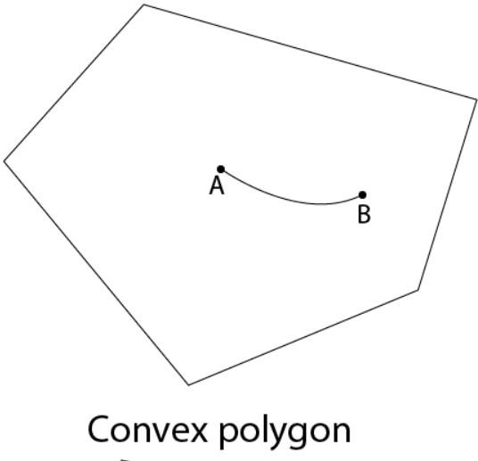
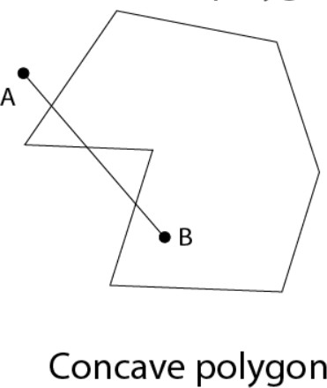
polygon
Types of Polygons
Convex: A polygon is called convex of line joining any two interior points of the polygon lies inside the polygon. All interior angles are less than 180°.
Concave: A non-convex polygon is said to be concave. A concave polygon has one interior angle greater than 180°.

Slide 10
Polygon Clipping
For polygon clipping we need to modify the line clipping procedure.
In line clipping we need to consider about only line segment.
In polygon clipping we need to consider the area and the new boundary of the polygon after clipping.
Various algorithm available for polygon clipping are:
Sutherland-Hodgeman Polygon Clipping
Weiler-Atherton Polygon Clipping etc.

Slide 11
Sutherland-Hodgeman Polygon Clipping
For correctly clip a polygon we process the polygon boundary as a whole against each window edge.
This is done by whole polygon vertices against each clip rectangle boundary one by one.
Left Clipper
Right Clipper
Bottom Clipper
Top Clipper
in
out

Slide 12
Processing Steps
We process vertices in sequence as a closed polygon.
Four possible cases are there.
Inside Outside
A D
B
C
If both vertices are inside the window we add only second vertex
to output list.
If first vertex is inside the boundary and second vertex is outside the boundary only the edge intersection with the window boundary is added to the output vertex list.
If both vertices are outside the window boundary nothing is added to window boundary.
first vertex is outside and second vertex is inside the boundary, then adds both intersection point with window boundary, and second vertex to the output list.

Slide 13
Example
3
2’
2
1’
1
4
6
5
As shown in figure we clip against left boundary.
Vertices 1 and 2 are found to be on the outside of the boundary.
Then we move to vertex 3, which is inside, we calculate the intersection and add both intersection point and vertex 3 to output list.

Slide 14
Contd.
3
2’
2
1’
1
3’
4
6
5’
4’
5
Then we move to vertex 4 in which vertex 3 and 4 both are inside so we add vertex 4 to
output list.
Similarly from 4 to 5 we add 5 to output list.
From 5 to 6 we move inside to outside so we add intersection pint to output list.
Finally 6 to 1 both vertex are outside the window so we does not add anything.

Slide 15
Limitatin of Sutherlan-Hodgeman Algorithm
It may not clip concave polygon properly.
V₂
V₃
V₁
V₄
V₆
V₅
One possible solution is to divide polygon into numbers of small convex polygon and then
process one by one.
Another approach is to use Weiler-Atherton algorithm.

Slide 16
Weiler-Atherton Polygon Clipping
It modifies Sutherland-Hodgeman vertex processing procedure for window boundary so that concave polygon also clip correctly.
This can be applied for arbitrary polygon clipping regions as it is developed for visible
surface identification.
Procedure is similar to Sutherland-Hodgeman algorithm.
Only change is sometimes need to follow the window boundaries Instead of always follow
polygon boundaries.
For clockwise processing of polygon vertices we use the following rules:
For an outside to inside pair of vertices, follow the polygon boundary.
For an inside to outside pair of vertices, follow the window boundary in a clockwise direction.

Slide 17
Example
V₂’ _{V2}
V₁’
V₃
V₁
V₄’ V₃’
V₄
V₆
V₅
Start from v1 and move clockwise towards v2 and add intersection point and next point to output list by following polygon boundary,
then from v2 to v3 we add v3 to output list.
From v3 to v4 we calculate intersection point and add to output
list and follow window boundary.

Slide 18
Contd.
V₂’ _{V2}
V₁’
V₃
V₄’ V₃’
V₁
V₄
V₅’
V₇’
V₅
V
6
V₆’
Similarly from v4 to v5 we add intersection point and next point
and follow the polygon boundary,
next we move v5 to v6 and add intersection point and follow the
window boundary, and
finally v6 to v1 is outside so no need to add anything.
This way we get two separate polygon section after clipping.

